Slide 1

Life ’26 Campaign Identity
Ever feel like something’s missing?

Slide 2
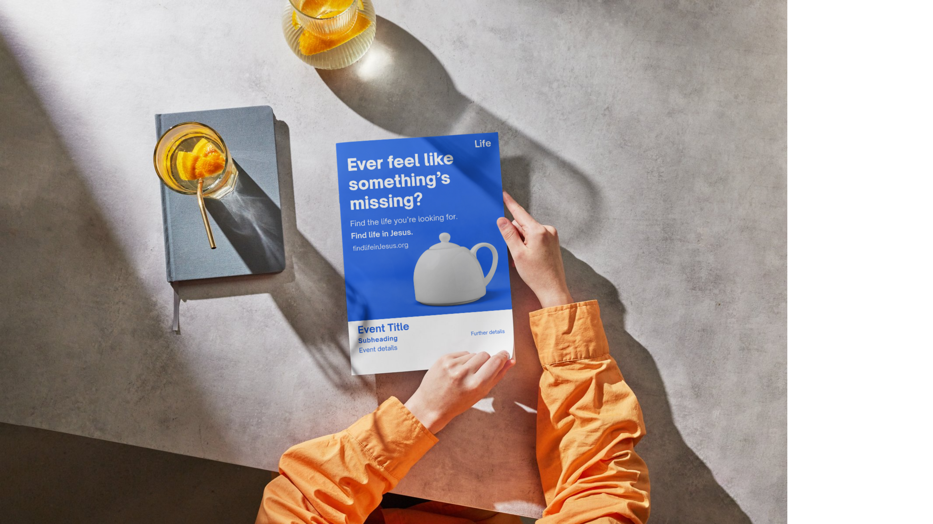

Slide 3
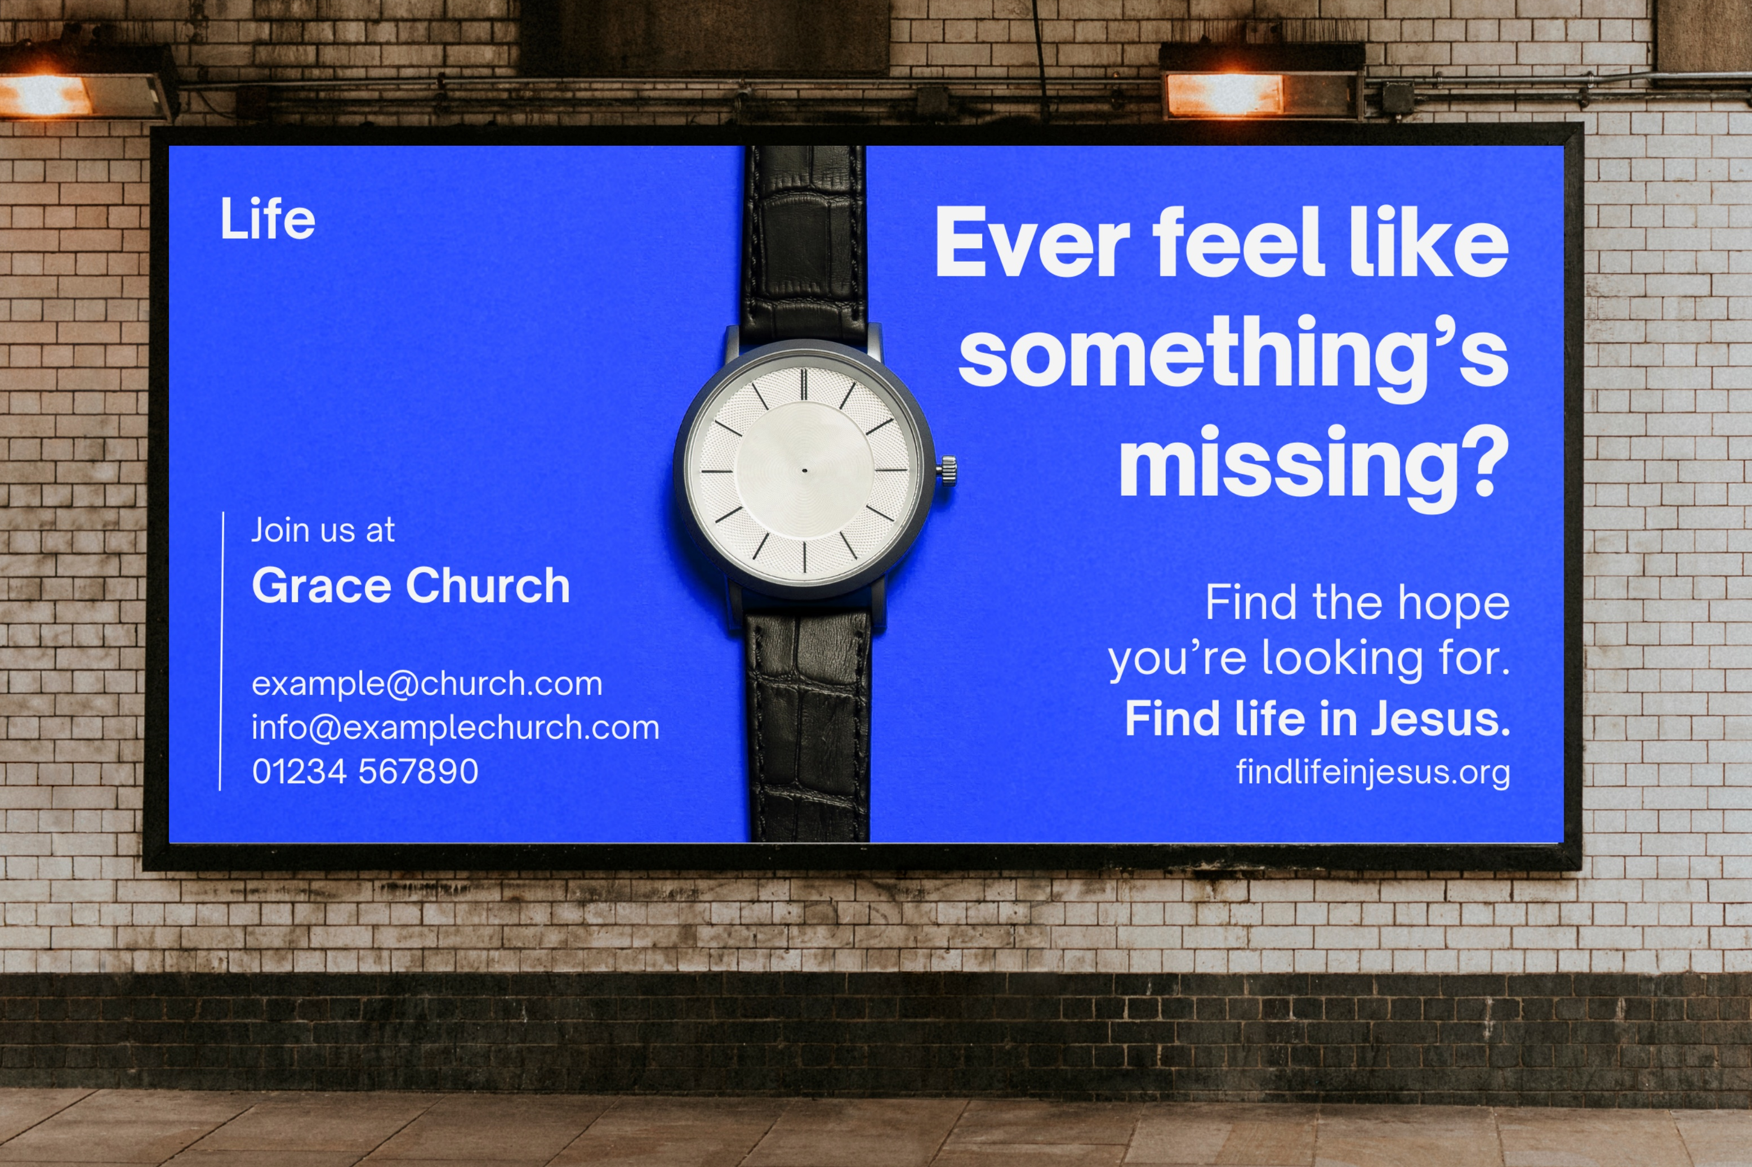
Ever feel like something’s missing?
Imagine this question all around your town, city or village. On posters, billboards and flyers; in newspapers; being shared through social media. Together with an invitation, a call, to find life in Jesus.

Slide 4

The imagery and wording that together constitute the campaign identity have been designed by our friends at Something More Creative to be eye-catching; arouse interest; and be up front that the Life ‘26 mission is all about inviting people to find life in Jesus.
Visually the adverts playfully arouse interest with images of everyday objects with something essential missing, such as a tennis racquet with no strings or a road sign with no words. The big question asked in the headline engages with the growing awareness in the culture that something is missing.

Slide 5
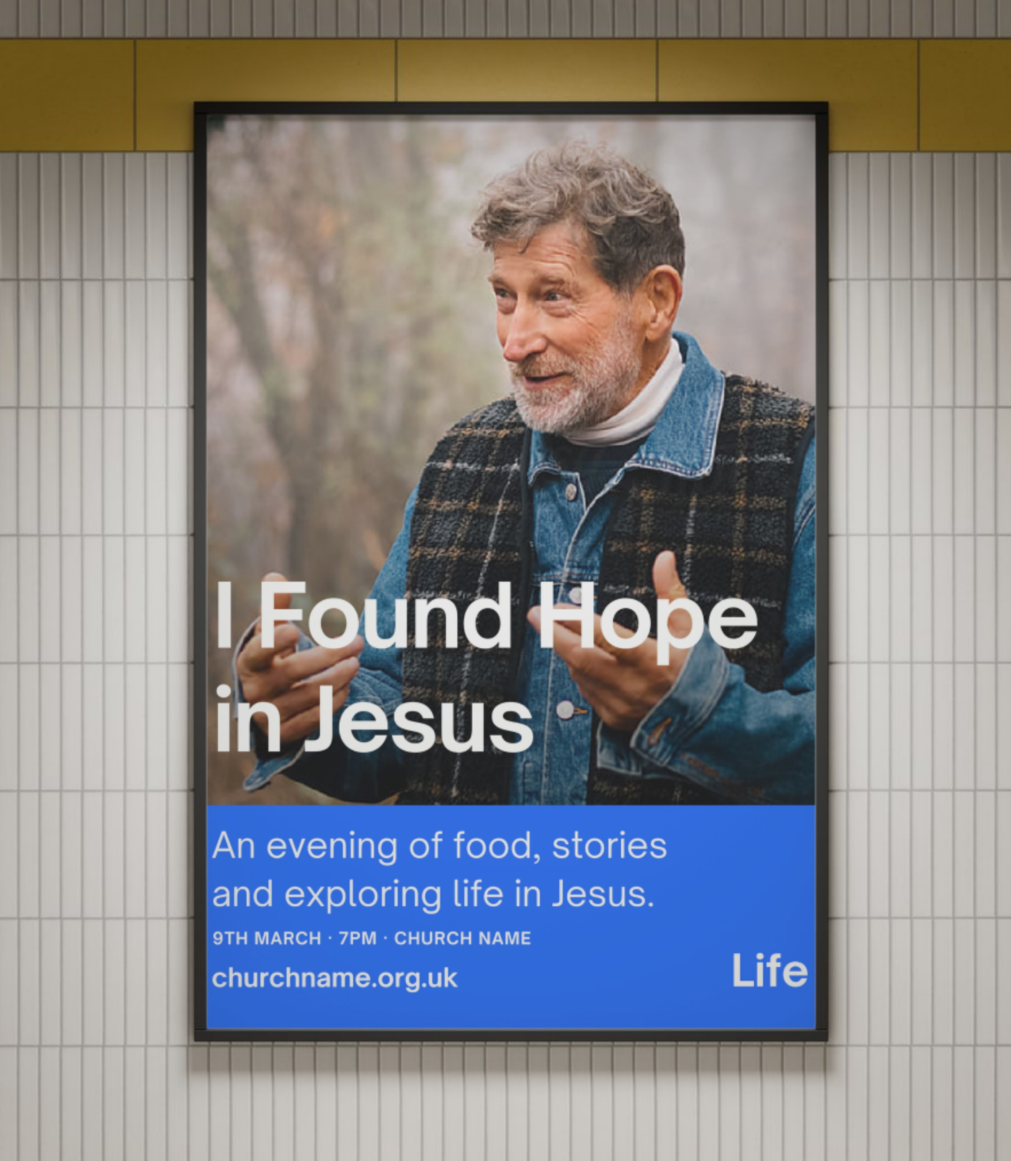
There is a crisis of identity in our culture, and people are looking for a better story that gives them purpose, meaning, joy and peace.
Anecdotally we were hearing rumours of more and more people showing up at churches with the same statement: “I feel like something’s missing.”
The Finding Jesus research conducted by the Evangelical Alliance confirmed that this sense of ‘something missing’ is motivating many in their exploration of the Christian faith.

Slide 6
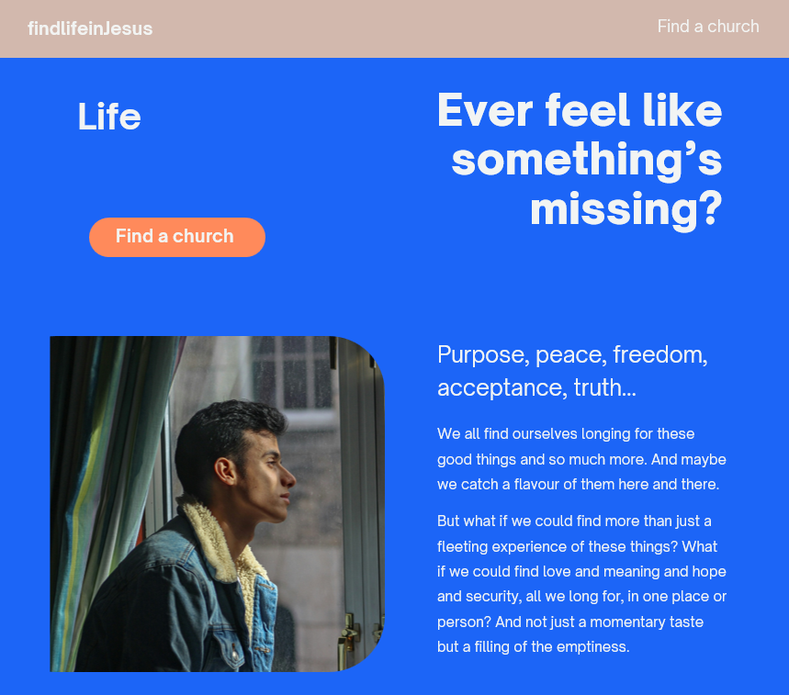
The campaign invites people to find the life, peace, purpose, hope, security, forgiveness (and more) that they are looking for by finding life in Jesus. Any word that reflects a blessing of the gospel – the life to the full that Jesus offers – can be used in the strapline.
Find the …… you are looking for.
Find life in Jesus
The public-facing website findlifeinJesus.org will point people to Jesus and help them find a church where they can find out more.

Slide 7
advertising your events, services, and other outreach?
First select which images you want to use from our image bank

Slide 8



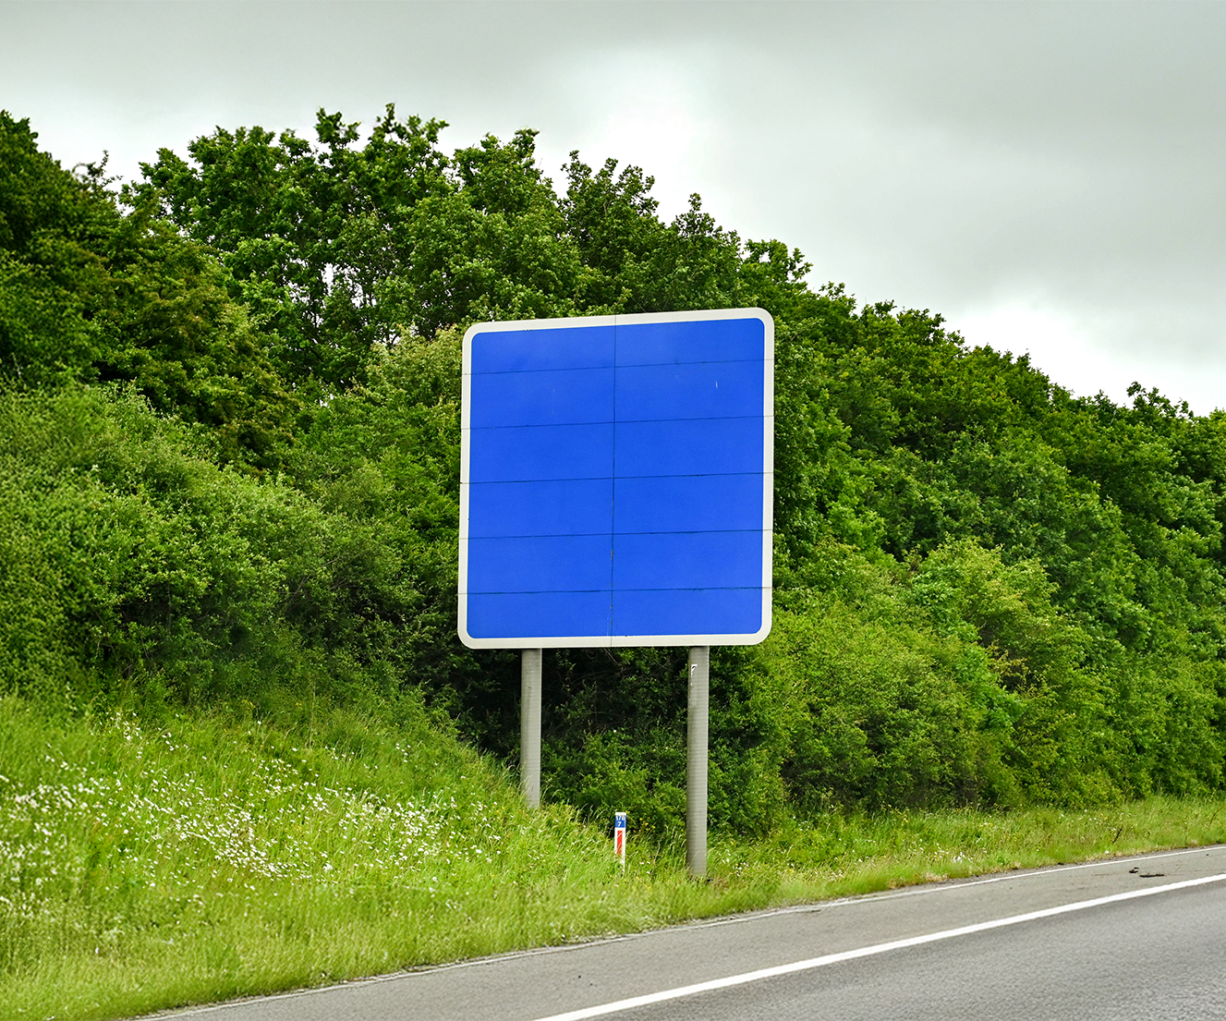

Slide 9






Slide 10
Then use our publicity generator to build your own posters, flyers, social media posts, banners and more!

Slide 11
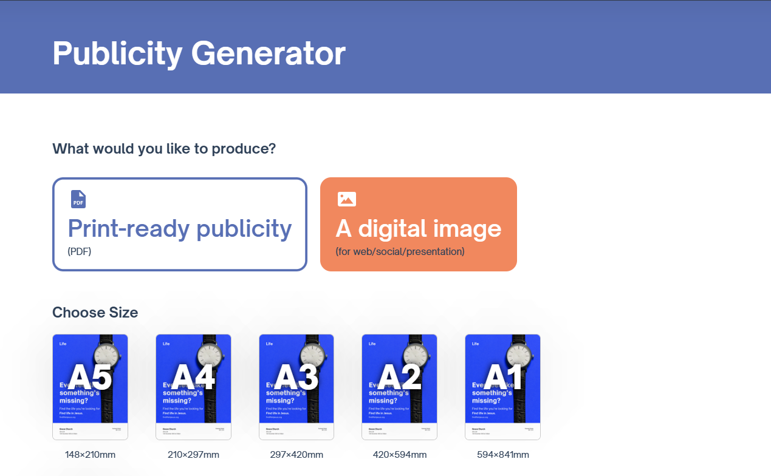

Slide 12
or download one of our many Canva templates to create your own…

Slide 13
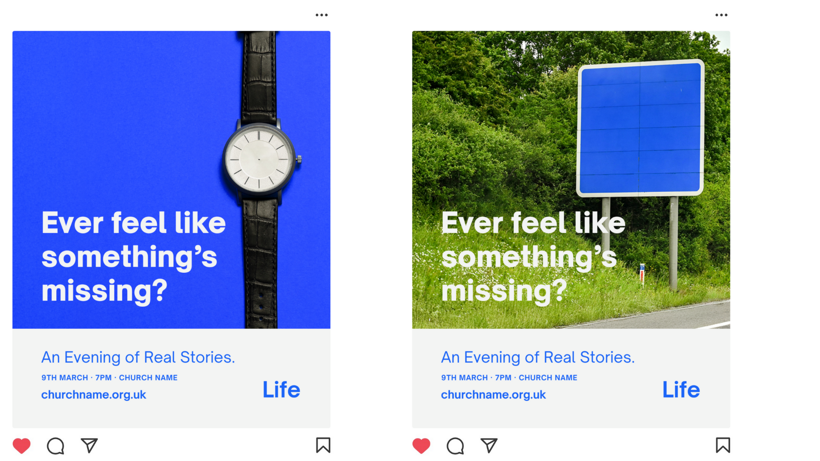
social media posts

Slide 14
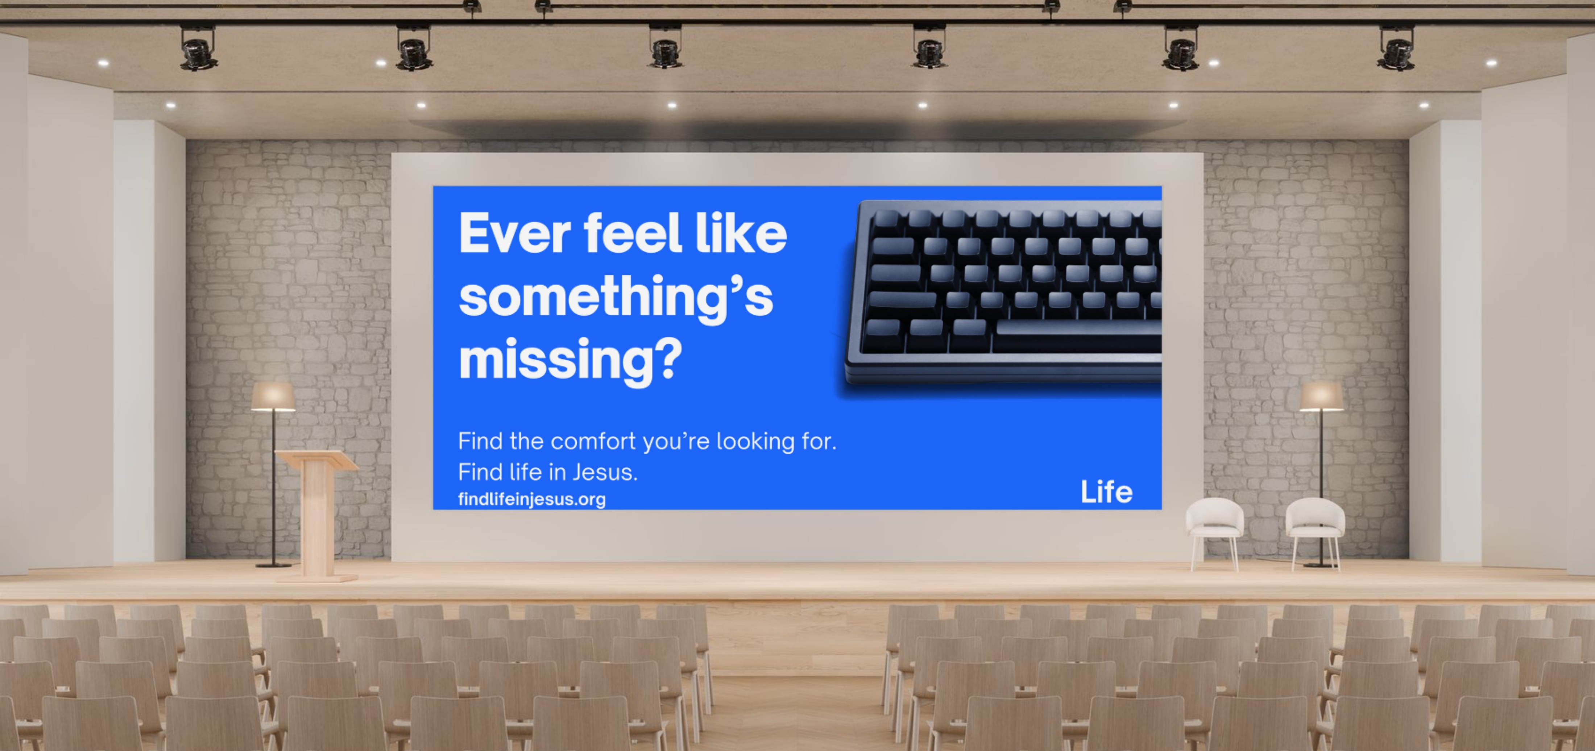
PowerPoints

Slide 15

web banners

Slide 16

And printed publicity
Flyers
Posters
Banners
Billboards

Slide 17
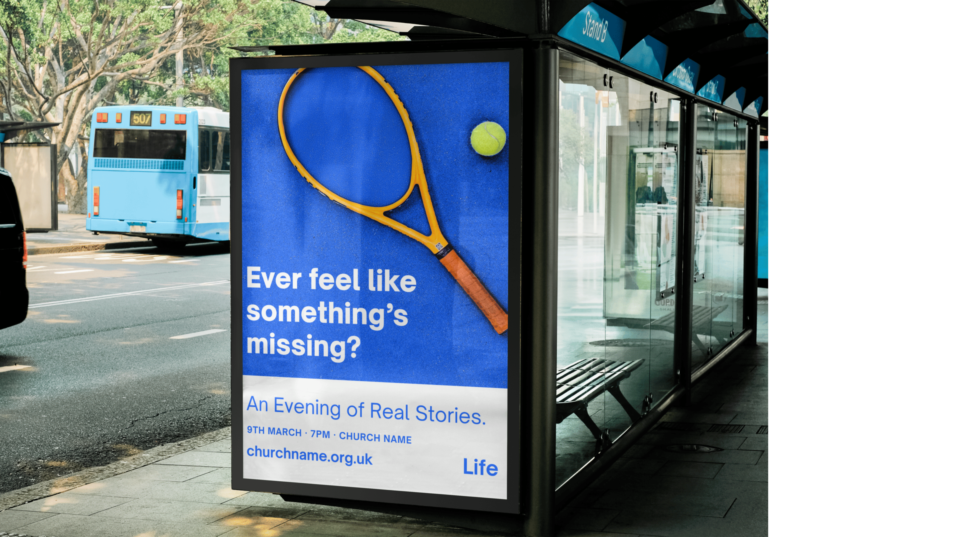

Slide 18
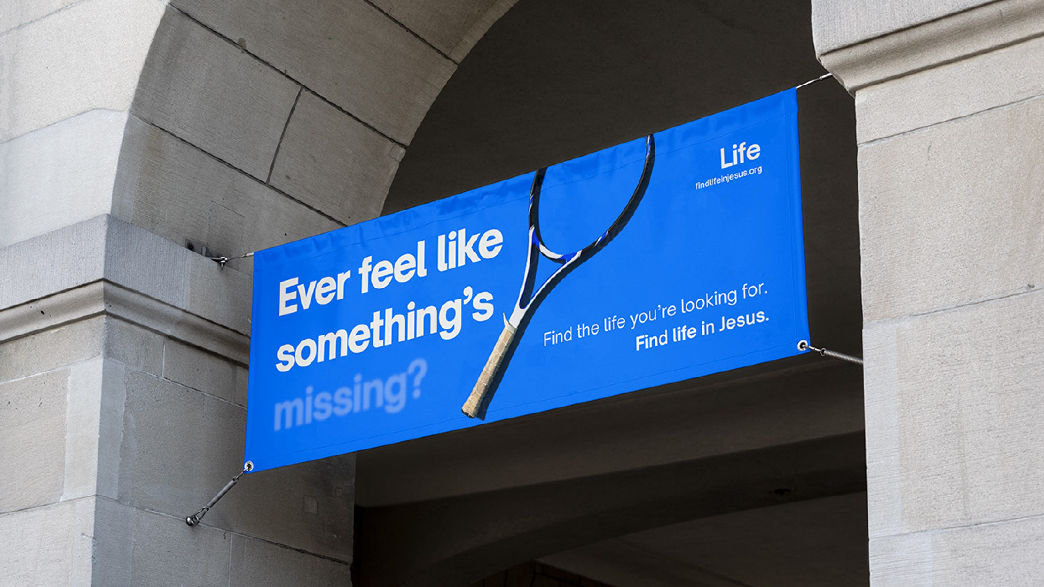

Slide 19
prefer to design your own from scratch?
download the campaign imagery, fonts and more to create eye-catching publicity to fit your needs!

Slide 20


Slide 21

LIFE ‘26 is a nationwide gospel mission through local churches beginning March 2026.
Churches across the whole of the UK are joining together to invite people in their communities to find life in Jesus
Join the LIFE ‘26 mission today
Together we can reach our nation(s) with the gospel apassionforlife.org.uk/life26

